Slide 1
CSE-2021-SD
Institute/School Name | Chitkara University Institute of Engineering and Technology
Department Name | Department of Computer Science & Engineering
Programme Name | Bachelor of Engineering (B.E.), Computer Science & Engineering
Course Name | SYSTEM DESIGN | Session | 2023-2024
Course Code | CS254H | Semester/Batch | 5th/2021
L-T-P (Per Week) | 2-0-0 | Course Credits | 02
Course Coordinator | Dr. Parul

Slide 2
Course Outcomes
CLO01 | Distinguish concepts related to processes, threads, process scheduling, race conditions and critical sections.
CLO02 | Examine and categorize various memory management techniques like caching, paging, segmentation, virtual memory, and thrashing; Design and implement file management system.
CLO03 | Construct the SQL queries for given specifications.
CLO04 | Explain the functions of the different layer of the OSI Protocol.

Slide 3
CLO-01 Lecture -19-30

Slide 4
Software engineering
Software engineering is the branch of computer science that deals with the design, development, testing, and maintenance of software applications.
It is a systematic and disciplined approach to software development that aims to create high-quality, reliable, and maintainable software.
By following the principles of software engineering and using the appropriate tools and methodologies, software developers can create high-quality, reliable, and maintainable software that meets the needs of its users.
Software engineers uses a process to develop software with the highest quality and lowest cost in the shortest time possible known as SDLC

Slide 5
Software Development life Cycle

Slide 6
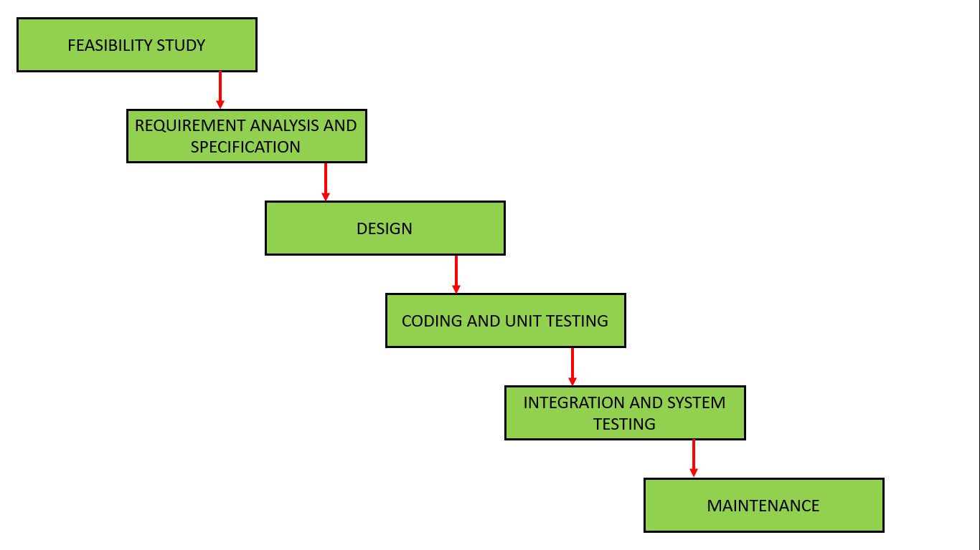
Waterfall Model

Slide 7
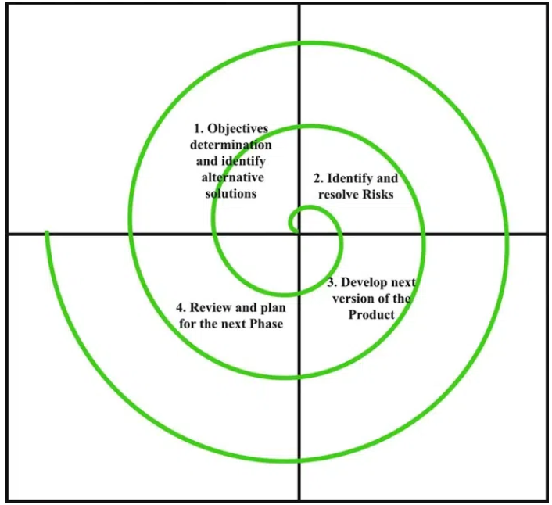
Spiral Model

Slide 8
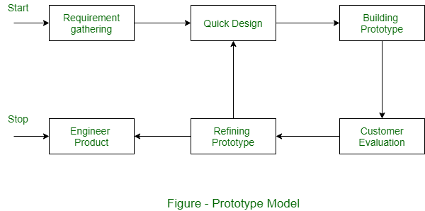
Prototype Model

Slide 9
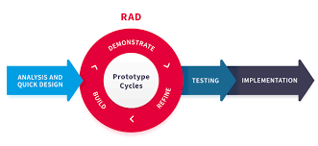
RAD (Rapid Application Development) Model

Slide 10
Agile Model
"Agile process model" refers to a software development approach based on iterative development.
Agile methods break tasks into smaller iterations, or parts do not directly involve long term planning.
The project scope and requirements are laid down at the beginning of the development process. Plans regarding the number of iterations, the duration and the scope of each iteration are clearly defined in advance.
Each iteration is considered as a short time "frame" in the Agile process model, which typically lasts from one to four weeks.
The division of the entire project into smaller parts helps to minimize the project risk and to reduce the overall project delivery time requirements. Each iteration involves a team working through a full software development life cycle.

Slide 11
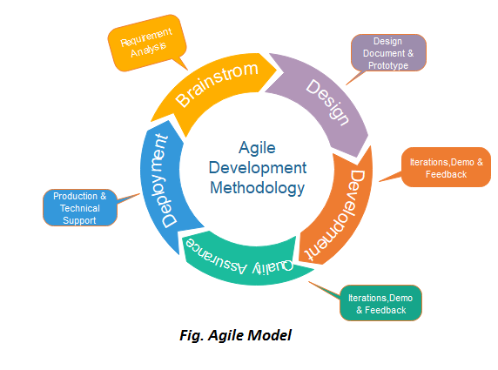
Agile Model

Slide 12
Phases in the Agile model
Requirements gathering
Design the requirements
Construction/ iteration
Testing/ Quality assurance
Deployment
Feedback

Slide 13
Requirement Gathering
Agile requirements gathering is a collaborative and iterative process that aims to deliver value and quality to your customers by understanding their needs, expectations, and feedback.
Some effective requirements gathering techniques are :
Interviews Questionnaires or Surveys
User Observation Document Analysis
Interface Analysis Workshops
Brainstorming Role-Play
Use Cases and Scenarios Focus Groups
Prototyping

Slide 14
High-level Design(HLD)
High-level Design explains the architecture that would be used to develop a system.
The architecture diagram provides an overview of an entire system, identifying the main components that would be developed for the product and their interfaces.
The HLD can use non-technical to mildly technical terms which should be understandable to the administrators of the system
In High-Level Design, the designers only focus on the various models, like:
Decision Tables
Decision Trees
Flow Diagrams
Flow Charts
Data Dictionary

Slide 15
Decision Tables
Decision tables are a concise visual representation for specifying which actions to perform depending on given conditions. They are algorithms whose output is a set of actions.
It is a tabular representation of decision points and corresponding actions in a system.
The information expressed in decision tables could also be represented as decision trees or in a programming language as a series of if-then-else and switch-case statements.

Slide 16
Decision Tables (Leap Year)
Condition | Condition Entry
Year is divisible by 4 | √ | √ | √ | x
Year is divisible by 100 | x | √ | √ | x
Year is divisible by 400 | x | √ | x | x
Otherwise
Action | Action Entry
 | √ | √ | x | x
Leap Year
 | x | x | √ | √
Not a leap Year

Slide 17
Decision Tables Library Policy/Rule
A teacher can take book for full semester
A student can take book for 2 weeks
A visitor can take for 1 week after submitting some security money.
If book is not available teacher/ student can reserve book.
If there is delay then student is fined Rs 50
If there is delay then visitor is fined Rs 100
Visitor seeks his security money after returning the book

Slide 18
Decision Tables Library Policy/Rule
Divide the statements in conditions and actions

Slide 19
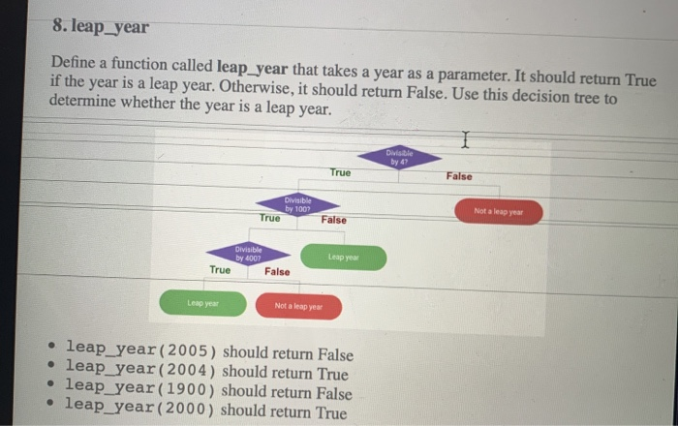
Decision Tree

Slide 20
Data flow Diagram
A data flow diagram (DFD) maps out the flow of information for any process or system. It uses defined symbols like rectangles, circles and arrows, plus short text labels, to show data inputs, outputs, storage points and the routes between each destination.
DFD can often visually “say” things that would be hard to explain in words, and they work for both technical and nontechnical audiences, from developer to CEO.

Slide 21
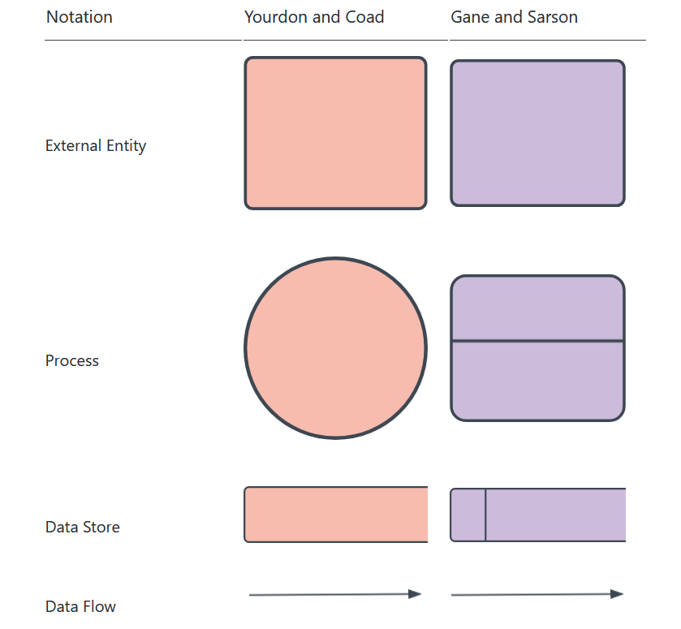
Symbols and Notations Used in DFDs

Slide 22
DFD rules and tips
Each process should have at least one input and an output.
Each data store should have at least one data flow in and one data flow out.
Data stored in a system must go through a process.
All processes in a DFD go to another process or a data store.
A data flow diagram can dive into progressively more detail by using levels and layers, zeroing in on a particular piece.
DFD levels are numbered 0, 1 or 2, and occasionally go to even Level 3 or beyond. The necessary level of detail depends on the scope of what you are trying to accomplish.

Slide 23
Flow Chart
A flowchart is a type of diagram that represents a workflow or process. A flowchart can also be defined as a diagrammatic representation of an algorithm, a step-by-step approach to solving a task. The flowchart shows the steps as boxes of various kinds, and their order by connecting the boxes with arrows.

Slide 24
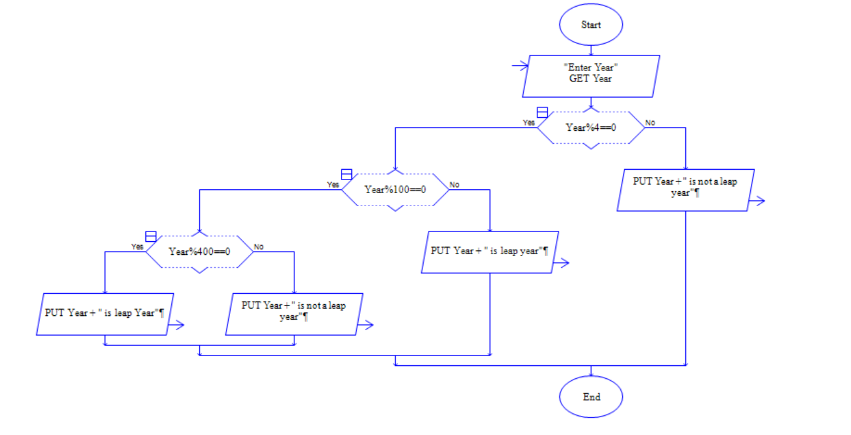

Slide 25
Data Dictionary
A data dictionary is a structured repository of metadata that provides a comprehensive description of the data used.
Its main purpose is to provide a common language and understanding of:
The data
Its meaning
How it relates to other data elements
Data dictionary provides additional context and information about each data point so that analysts can understand the data better.

Slide 26
Types of data dictionaries
Active data dictionary :
An active data dictionary is a document that's updated whenever changes are made to the data in a database.
Usually managed by the IT department, this type of data dictionary is and provides up-to-date definitions for each piece of data in a database or system.
This form of data dictionary actively prevents any discrepancies or changes in data integrity.
Passive data dictionary :
A passive data dictionary is usually a static document that's manually updated and not tied to any system or database. This type of data dictionary is typically used for reference purposes, such as in analytics projects where analysts need to understand the meaning of different data points and their relationships with each other.

Slide 27
Components of a data dictionary
Data Element Name: This is the name of the data element.
Data Type: This describes the type of data that can be stored in a field, such as text or numeric.
Domain Value: A domain value defines what values can be used for a particular data element.
Definition/Description: This explains the data element, its purpose and its context.
Source: This describes where the data element is sourced from.
Date Created: This records the date when the data element was created.
Last Updated: This records the date when the last updates were made.
Approved By: This is a record that shows who approved the data element.
Owner: This is a record that shows who is responsible for maintaining and updating the data element.
Relationships: This describes how the data element relates to other elements within the system or database.
Validation rules: This describes any business rules that need to be applied to the data element.

Slide 28
Benefits of having & using a data dictionary
Better communication
Improved data quality
Easier maintenance
Easily searchable

Slide 29
How to create a data dictionary
Step 1. Identify your data elements :Start by listing out the different data elements in your database. Collect information about each element, such as:
Name
Type
Source
Other related information
Step 2. Document the structure : document the structure of your database to understand how different data elements are connected. List all relationships between data elements to provide a clear picture of the entire database.
Step 3. Define each data element :For each data element, define its purpose, domain value and any other definitions you need. Doing so will ensure that all stakeholders have a shared understanding of it.
Step 4. Set up validation rules :Validation rules help ensure accurate input into the database, so make sure to document them in your data dictionary.
Step 5. Monitor and update :Your data dictionary should be kept up-to-date with changes made to the database. Therefore, having someone responsible for monitoring and updating it is crucial.

Slide 30
Users who can update a data dictionary
Database administrator
Data engineer
Data analyst
Business intelligence analyst

Slide 31
Database
The database is a collection of inter-related data which is used to retrieve, insert and delete the data efficiently. It is also used to organize the data in the form of a table, schema, views, and reports, etc.

Slide 32

Low Level Design

Slide 33
Low Level Design
Low-level design is an important phase of the software development process, because in this phase, the design is translated into concrete implementation details.
This phase of the design process focuses on defining the data structures, algorithms, and interactions between the components that will be used to implement the system.
It is also concerned with defining the interfaces between the various components and the protocols used for communication between them.
In Low-level design we use various techniques such as object-oriented design, design patterns, and UML (Unified Modeling Language) diagrams to define the detailed design of the system.
Developers then use this design to implement the system, ensuring that the system is built according to the specifications defined in the low-level design.

Slide 34
Steps involved in the low-level design
Understanding requirements: The first step in low-level design is understanding the system's requirements. This includes reviewing the requirements document, talking to stakeholders, and gathering additional information to better understand what the system should do.
Defining the architecture: Once the requirements are understood, the next step is to define the system's architecture. This involves identifying the various components that make up the system and defining how they will interact with each other.
Designing the components: After defining the architecture, the next step is to design each component in detail. This includes specifying the data structures and algorithms to be used, and defining the interfaces between components.
Defining protocols: In this step, the protocols that will be used for communication between components are defined. This includes specifying the data formats, message structures, and communication protocols that will be used.
Creating UML diagrams: To help communicate the design, UML (Unified Modeling Language) diagrams may be created to illustrate the architecture and the interactions between components.
Reviewing the design: Once the design is completed, it must be reviewed to ensure that it meets the requirements and is technically sound. This may include obtaining feedback from stakeholders and conducting peer reviews.
Refining the design: If necessary, the design can be refined based on feedback received during the review process. This may involve changing the data structures, algorithms, or protocols used in the design.
Documenting the design: Once the design has been finalized, it is important to document it in a way that is clear, concise, and easy to understand. This may involve creating detailed design specifications or creating diagrams and flowcharts to illustrate the design.

Slide 35
Roadmap to Low Level Design (LLD)
Object-Oriented Principles
Process of Analyzing and Design
Design Patterns
UML Diagram
SOLID Principles
Single Responsibility
Open/Closed Principle
Liskov Substitution
Interface Segregation
Dependency Inversion

Slide 36
Database Management System
Database management system is a software which is used to manage the database. For example: MySQL, Oracle, etc are a very popular commercial database which is used in different applications.
DBMS provides an interface to perform various operations like database creation, storing data in it, updating data, creating a table in the database and a lot more.
It provides protection and security to the database. In the case of multiple users, it also maintains data consistency.

Slide 37
DBMS allows users the following tasks:
Data Definition: It is used for creation, modification, and removal of definition that defines the organization of data in the database.
Data Updation: It is used for the insertion, modification, and deletion of the actual data in the database.
Data Retrieval: It is used to retrieve the data from the database which can be used by applications for various purposes.
User Administration: It is used for registering and monitoring users, maintain data integrity, enforcing data security, dealing with concurrency control, monitoring performance and recovering information corrupted by unexpected failure.

Slide 38
Characteristics of DBMS
It uses a digital repository established on a server to store and manage the information.
It can provide a clear and logical view of the process that manipulates data.
DBMS contains automatic backup and recovery procedures.
It contains ACID properties which maintain data in a healthy state in case of failure.
It can reduce the complex relationship between data.
It is used to support manipulation and processing of data.
It is used to provide security of data.
It can view the database from different viewpoints according to the requirements of the user.

Slide 39
Advantages of DBMS
Controls data redundancy: It can control data redundancy because it stores all the data in one single database file and that recorded data is placed in the database.
Data sharing: In DBMS, the authorized users of an organization can share the data among multiple users.
Easily Maintenance: It can be easily maintainable due to the centralized nature of the database system.
Reduce time: It reduces development time and maintenance need.
Backup: It provides backup and recovery subsystems which create automatic backup of data from hardware and software failures and restores the data if required.
multiple user interface: It provides different types of user interfaces like graphical user interfaces, application program interfaces

Slide 40
SQL
SQL or Structured Query Language is used to operate on the data stored in a database. SQL depends on relational algebra and tuple relational calculus.

Slide 41
NoSQL Database
A NoSQL database is an approach to design such databases that can accommodate a wide variety of data models. NoSQL stands for "not only SQL." It is an alternative to traditional relational databases in which data is placed in tables, and data schema is perfectly designed before the database is built.
NoSQL databases are useful for a large set of distributed data.
Some examples of NoSQL database system with their category are:
MongoDB, CouchDB, Cloudant (Document-based)
Memcached, Redis, Coherence (key-value store)
HBase, Big Table, Accumulo (Tabular)

Slide 42
Normalization
Normalization is the process to eliminate data redundancy and enhance data integrity in the table.
Normalization also helps to organize the data in the database.
It is a multi-step process that sets the data into tabular form and removes the duplicated data from the relational tables.
Normalization organizes the columns and tables of a database to ensure that database integrity constraints properly execute their dependencies.
It is a systematic technique of decomposing tables to eliminate data redundancy (repetition) and undesirable characteristics like Insertion, Update, and Deletion anomalies.

Slide 43
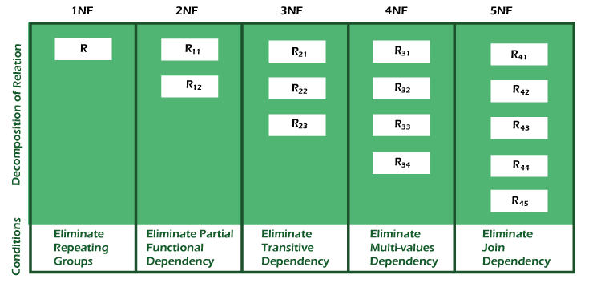
Types of Normal Forms

Slide 44
Normal Form | Description
1NF | A relation is in 1NF if it contains an atomic value.
2NF | A relation will be in 2NF if it is in 1NF and all non-key attributes are fully functional dependent on the primary key.
3NF | A relation will be in 3NF if it is in 2NF and no transition dependency exists.
BCNF | A stronger definition of 3NF is known as Boyce Codd's normal form.
4NF | A relation will be in 4NF if it is in Boyce Codd's normal form and has no multi-valued dependency.
5NF | A relation is in 5NF. If it is in 4NF and does not contain any join dependency, joining should be lossless.

Slide 45
First Normal Form (1NF)
A relation will be 1NF if it contains an atomic value.
It states that an attribute of a table cannot hold multiple values. It must hold only single-valued attribute.
First normal form disallows the multi-valued attribute, composite attribute, and their combinations.

Slide 46
First Normal Form (1NF)
EMP_ID | EMP_NAME | EMP_PHONE | EMP_STATE
14 | John | 7272826385, 9064738238 | UP
20 | Harry | 8574783832 | Bihar
12 | Sam | 7390372389, 8589830302 | Punjab
EMP_ID | EMP_NAME | EMP_PHONE | EMP_STATE
14 | John | 7272826385 | UP
14 | John | 9064738238 | UP
20 | Harry | 8574783832 | Bihar
12 | Sam | 7390372389 | Punjab
12 | Sam | 8589830302 | Punjab

Slide 47
Second Normal Form (2NF)
In the 2NF, relational must be in 1NF.
In the second normal form, all non-key attributes are fully functional dependent on the primary key
Example: Let's assume, a school can store the data of teachers and the subjects they teach. In a school, a teacher can teach more than one subject.

Slide 48
Second Normal Form (2NF)
TEACHER_ID | SUBJECT | TEACHER_AGE
25 | Chemistry | 30
25 | Biology | 30
47 | English | 35
83 | Math | 38
83 | Computer | 38
TEACHER_ID | SUBJECT
25 | Chemistry
25 | Biology
47 | English
83 | Math
83 | Computer
TEACHER_ID | TEACHER_AGE
25 | 30
47 | 35
83 | 38

Slide 49
Third Normal Form (3NF)
A relation will be in 3NF if it is in 2NF and not contain any transitive partial dependency.
3NF is used to reduce the data duplication. It is also used to achieve the data integrity.
If there is no transitive dependency for non-prime attributes, then the relation must be in third normal form.
A relation is in third normal form if it holds at least one of the following conditions for every non-trivial function dependency X → Y.
X is a super key.
Y is a prime attribute, i.e., each element of Y is part of some candidate key.

Slide 50
Third Normal Form (3NF)
EMP_ID | EMP_NAME | EMP_ZIP | EMP_STATE | EMP_CITY
222 | Harry | 201010 | UP | Noida
333 | Stephan | 02228 | US | Boston
444 | Lan | 60007 | US | Chicago
555 | Katharine | 06389 | UK | Norwich
666 | John | 462007 | MP | Bhopal
EMP_ID | EMP_NAME | EMP_ZIP
222 | Harry | 201010
333 | Stephan | 02228
444 | Lan | 60007
555 | Katharine | 06389
666 | John | 462007
EMP_ZIP | EMP_STATE | EMP_CITY
201010 | UP | Noida
02228 | US | Boston
60007 | US | Chicago
06389 | UK | Norwich
462007 | MP | Bhopal

Slide 51
Boyce Codd normal form (BCNF)
BCNF is the advance version of 3NF. It is stricter than 3NF.
A table is in BCNF if every functional dependency X → Y, X is the super key of the table.
For BCNF, the table should be in 3NF, and for every FD, LHS is super key.

Slide 52
Boyce Codd normal form (BCNF)
EMP_ID | EMP_COUNTRY | EMP_DEPT | DEPT_TYPE | EMP_DEPT_NO
264 | India | Designing | D394 | 283
264 | India | Testing | D394 | 300
364 | UK | Stores | D283 | 232
364 | UK | Developing | D283 | 549
EMP_DEPT | DEPT_TYPE | EMP_DEPT_NO
Designing | D394 | 283
Testing | D394 | 300
Stores | D283 | 232
Developing | D283 | 549
EMP_ID | EMP_DEPT
D394 | 283
D394 | 300
D283 | 232
D283 | 549
EMP_ID | EMP_COUNTRY
264 | India
264 | India

Slide 53

Download and Install MySql

Slide 54
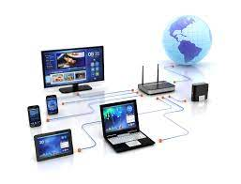
Computer Network

Slide 55
What is a Computer Network?
Computer Network is a group of computers connected with each other through wires, optical fibers or optical links so that various devices can interact with each other through a network.
The aim of the computer network is the sharing of resources among various devices.
In the case of computer network technology, there are several types of networks that vary from simple to complex level.

Slide 56
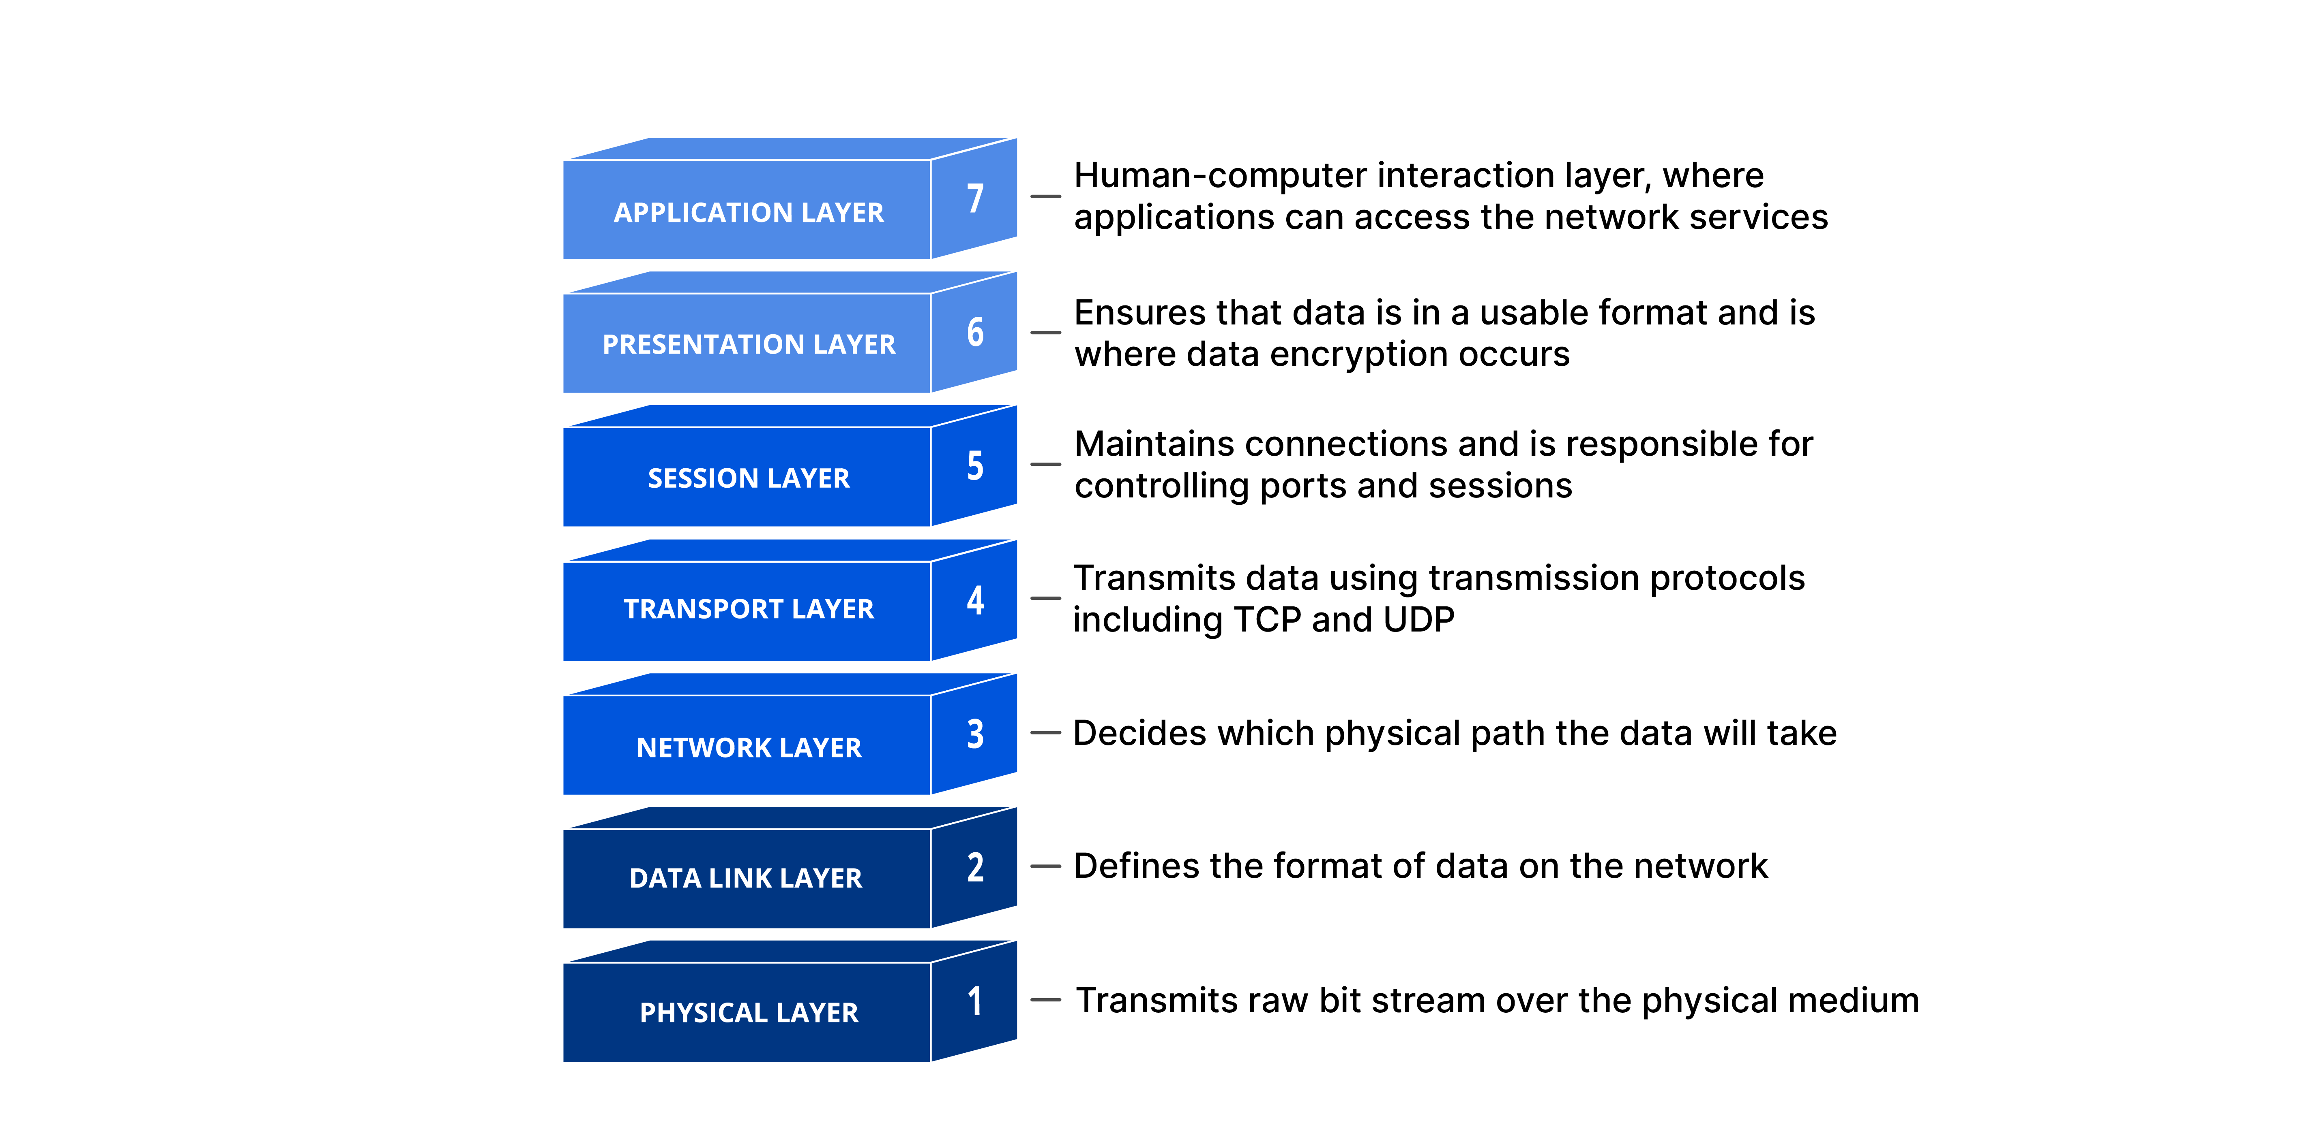
Conceptual View of Network

Slide 57
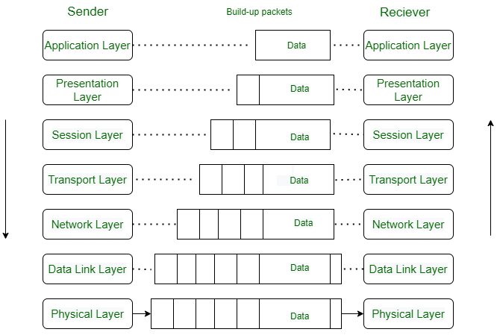
Conceptual View of Network

Slide 58
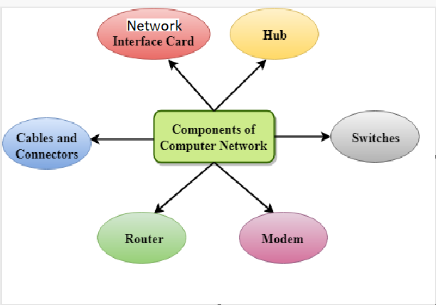
Components Of Computer Network

Slide 59
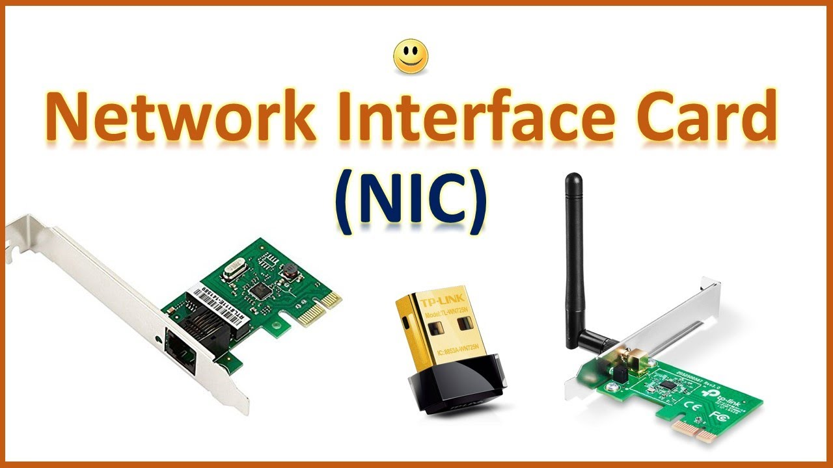
Network Interface Card

Slide 60
Network Interface Card
NIC is a device that helps the computer to connect with another device. The network interface card contains the hardware addresses, the data-link layer protocol use this address to identify the system on the network so that it transfers the data to the correct destination.
There are two types of NIC
Wireless NIC: All the modern laptops use the wireless NIC. In Wireless NIC, a connection is made using the antenna that employs the radio wave technology.
Wired NIC: Cables use the wired NIC to transfer the data over the medium.

Slide 61
Hub
Hub is a networking device which is used to connect multiple devices in a network.
Hub works at physical layer and broadcasts data to all the ports except from the port from which the data is being broadcasted.
Hub stores various ports, such that when packet arrives at one port it is copied to other ports.
Hub works in half-duplex mode. This device sends and receives data as electrical signals or binary bits.

Slide 62
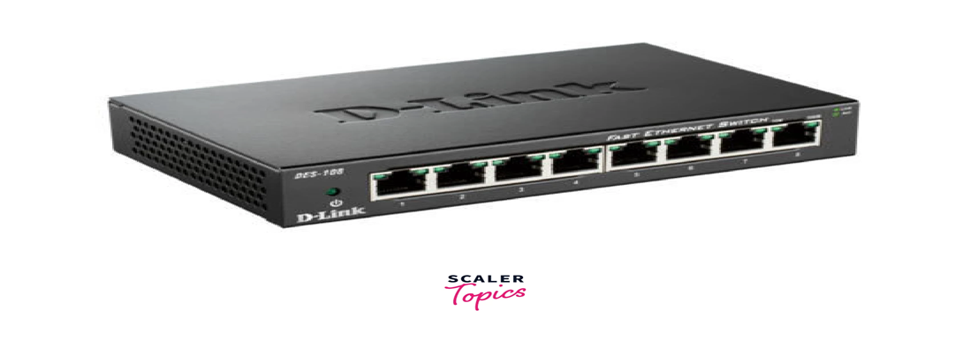

Slide 63
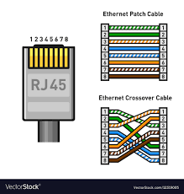
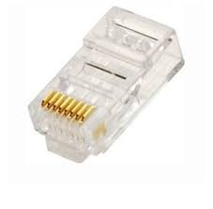
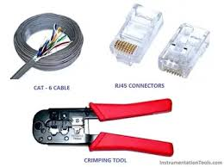
Wire and Connectors

Slide 64
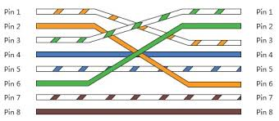
Crossover Cabling

Slide 65
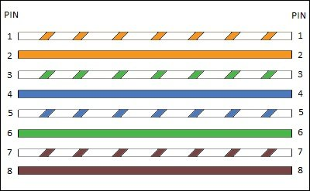
Straight through Cabling

Slide 66
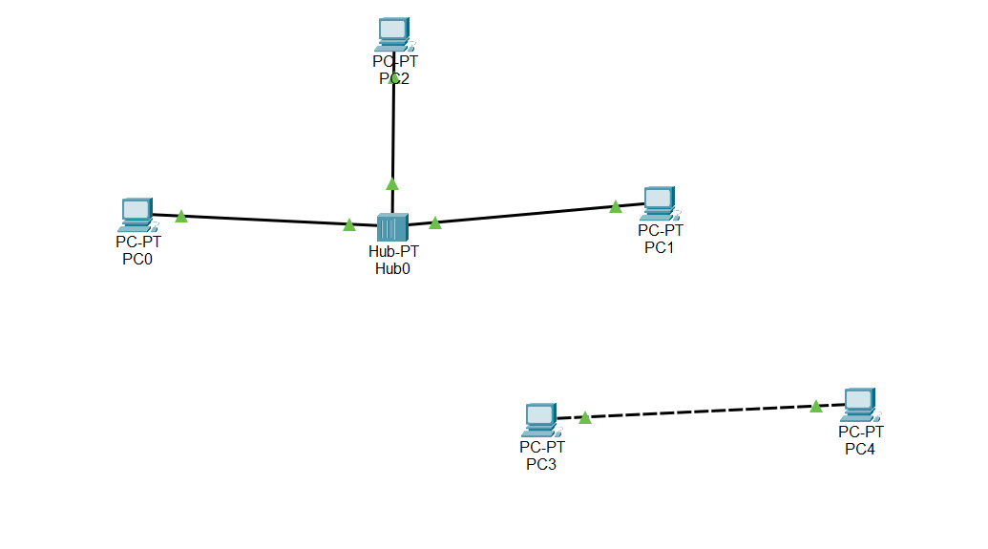

Slide 67
Network Cable Types and Specifications
There are three types of network cables
coaxial
twisted-pair
fiber-optic.

Slide 68
Coaxial cable
This cable contains a conductor, insulator, braiding, and sheath. The sheath covers the braiding, the braiding covers the insulation, and the insulation covers the conductor.

Slide 69
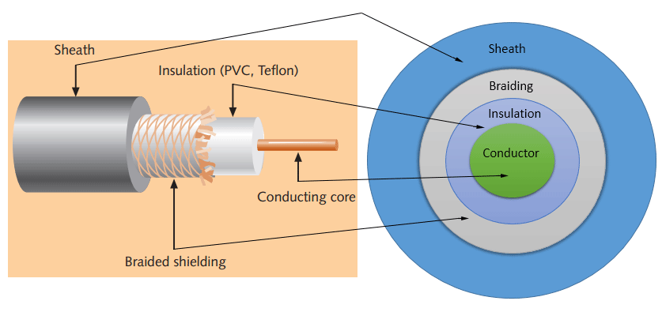
Coaxial cable

Slide 70
Coaxial cable
Sheath : This is the outer layer of the coaxial cable. It protects the cable from physical damage.
Braided shield : This shield protects signals from external interference and noise. This shield is built from the same metal that is used to build the core.
Insulation : Insulation protects the core. It also keeps the core separate from the braided shield. Since both the core and the braided shield use the same metal, without this layer, they will touch each other and create a short-circuit in the wire.

Slide 71
Coaxial cable
Conductor :The conductor carries electromagnetic signals. Based on conductor a coaxial cable can be categorized into two types; single-core coaxial cable and multi-core coaxial cable.
single-core coaxial cable uses a single central metal (usually copper) conductor.
multi-core coaxial cable uses multiple thin strands of metal wires. The following image shows both types of cable.

Slide 72
Twisted-pair cables
The twisted-pair cable was primarily developed for computer networks.
This cable is also known as Ethernet cable.
Almost all modern LAN computer networks use this cable.
This cable consists of color-coded pairs of insulated copper wires.
Every two wires are twisted around each other to form pair.
Each pair has one solid color and one stripped color wire.
Solid colors are blue, brown, green, and orange. In stripped color, the solid color is mixed with the white color.

Slide 73
Types :Twisted-pair cables
UTP (Unshielded twisted-pair) cable :All pairs are wrapped in a single plastic sheath.
STP (Shielded twisted-pair) cable : Each pair is wrapped with an additional metal shield, then all pairs are wrapped in a single outer plastic sheath.

Slide 74
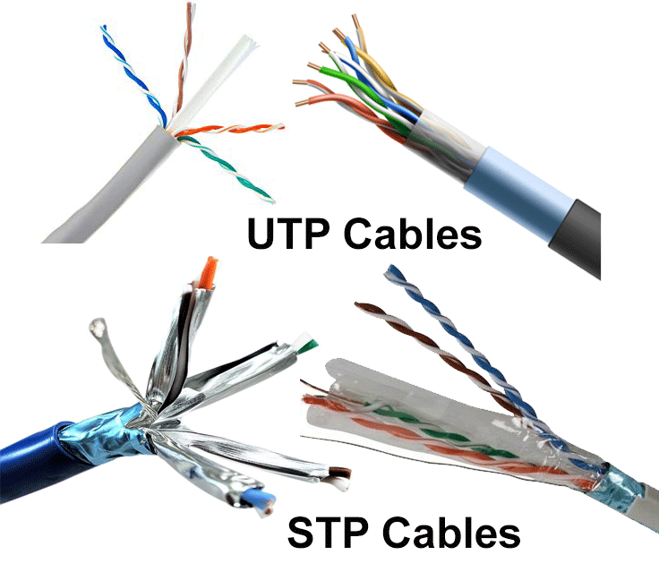

Slide 75
Fiber optic cable
This cable consists of
core
cladding
Buffer
jacket.
The core is made from thin strands of glass or plastic that can carry data over a long distance. The core is wrapped in the cladding; the cladding is wrapped in the buffer, and the buffer is wrapped in the jacket.

Slide 76
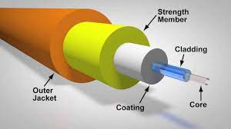

Slide 77
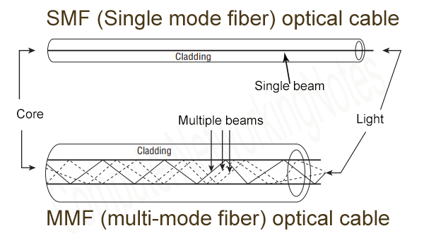

Slide 78
Topology
Topology defines the structure of the network of how all the components are interconnected to each other.
There are two types of topology:
Physical
Logical

Slide 79
Physical Topology
Physical topology is the geometric representation of all the nodes in a network.
There are six types of network topology :
Bus Topology
Ring Topology
Tree Topology
Star Topology
Mesh Topology
Hybrid Topology.

Slide 80
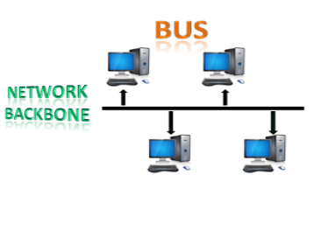
Bus Topology

Slide 81
Bus Topology
The bus topology is designed in such a way that all the stations are connected through a single cable known as a backbone cable.
Each node is either connected to the backbone cable by drop cable or directly connected to the backbone cable.
When a node wants to send a message over the network, it puts a message over the network. All the stations available in the network will receive the message whether it has been addressed or not.
The bus topology is mainly used in 802.3 (ethernet) and 802.4 standard networks.
The configuration of a bus topology is quite simpler as compared to other topologies.
The backbone cable is considered as a "single lane" through which the message is broadcast to all the stations.
The most common access method of the bus topologies is CSMA (Carrier Sense Multiple Access).

Slide 82
Bus Topology
CSMA: It is a media access control used to control the data flow so that data integrity is maintained, i.e., the packets do not get lost. There are two alternative ways of handling the problems that occur when two nodes send the messages simultaneously.
CSMA CD: CSMA CD (Collision detection) is an access method used to detect the collision. Once the collision is detected, the sender will stop transmitting the data. Therefore, it works on "recovery after the collision".
CSMA CA: CSMA CA (Collision Avoidance) is an access method used to avoid the collision by checking whether the transmission media is busy or not. If busy, then the sender waits until the media becomes idle. This technique effectively reduces the possibility of the collision. It does not work on "recovery after the collision".

Slide 83
Advantages of Bus topology:
Low-cost cable: In bus topology, nodes are directly connected to the cable without passing through a hub. Therefore, the initial cost of installation is low.
Moderate data speeds: Coaxial or twisted pair cables are mainly used in bus-based networks that support upto 10 Mbps.
Familiar technology: Bus topology is a familiar technology as the installation and troubleshooting techniques are well known, and hardware components are easily available.
Limited failure: A failure in one node will not have any effect on other nodes.

Slide 84
Disadvantages of Bus topology
Extensive cabling: A bus topology is quite simpler, but still it requires a lot of cabling.
Difficult troubleshooting: It requires specialized test equipment to determine the cable faults. If any fault occurs in the cable, then it would disrupt the communication for all the nodes.
Signal interference: If two nodes send the messages simultaneously, then the signals of both the nodes collide with each other.
Reconfiguration difficult: Adding new devices to the network would slow down the network.
Attenuation: Attenuation is a loss of signal leads to communication issues. Repeaters are used to regenerate the signal.

Slide 85
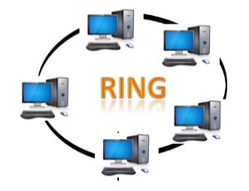
Ring Topology

Slide 86
Ring Topology
Ring topology is like a bus topology, but with connected ends.
The node that receives the message from the previous computer will retransmit to the next node.
The data flows in one direction, i.e., it is unidirectional.
The data flows in a single loop continuously known as an endless loop.
It has no terminated ends, i.e., each node is connected to other node and having no termination point.
The data in a ring topology flow in a clockwise direction.
The most common access method of the ring topology is token passing.
Token passing: It is a network access method in which token is passed from one node to another node.
Token: It is a frame that circulates around the network.

Slide 87
Working of Token passing
A token moves around the network, and it is passed from computer to computer until it reaches the destination.
The sender modifies the token by putting the address along with the data.
The data is passed from one device to another device until the destination address matches. Once the token received by the destination device, then it sends the acknowledgment to the sender.
In a ring topology, a token is used as a carrier.

Slide 88
Advantages of Ring topology
Network Management: Faulty devices can be removed from the network without bringing the network down.
Product availability: Many hardware and software tools for network operation and monitoring are available.
Cost: Twisted pair cabling is inexpensive and easily available. Therefore, the installation cost is very low.
Reliable: It is a more reliable network because the communication system is not dependent on the single host computer.

Slide 89
Disadvantages of Ring topology
Difficult troubleshooting: It requires specialized test equipment to determine the cable faults. If any fault occurs in the cable, then it would disrupt the communication for all the nodes.
Failure: The breakdown in one station leads to the failure of the overall network.
Reconfiguration difficult: Adding new devices to the network would slow down the network.
Delay: Communication delay is directly proportional to the number of nodes. Adding new devices increases the communication delay.

Slide 90
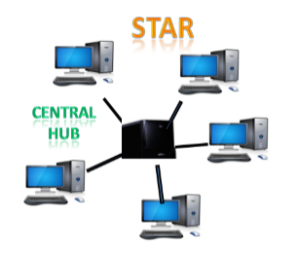
Star Topology

Slide 91
Star Topology
Star topology is an arrangement of the network in which every node is connected to the central hub, switch or a central computer.
The central computer is known as a server, and the peripheral devices attached to the server are known as clients.
Coaxial cable or RJ-45 cables are used to connect the computers.
Hubs or Switches are mainly used as connection devices in a physical star topology.
Star topology is the most popular topology in network implementation.

Slide 92
Advantages of Star topology
Efficient troubleshooting: Troubleshooting is quite efficient in a star topology as compared to bus topology. In a bus topology, the manager has to inspect the kilometers of cable. In a star topology, all the stations are connected to the centralized network. Therefore, the network administrator has to go to the single station to troubleshoot the problem.
Network control: Complex network control features can be easily implemented in the star topology. Any changes made in the star topology are automatically accommodated.
Limited failure: As each station is connected to the central hub with its own cable, therefore failure in one cable will not affect the entire network.
Familiar technology: Star topology is a familiar technology as its tools are cost-effective.
Easily expandable: It is easily expandable as new stations can be added to the open ports on the hub.
Cost effective: Star topology networks are cost-effective as it uses inexpensive coaxial cable.
High data speeds: It supports a bandwidth of approx 100Mbps. Ethernet 100BaseT is one of the most popular Star topology networks.

Slide 93
Disadvantages of Star topology
A Central point of failure: If the central hub or switch goes down, then all the connected nodes will not be able to communicate with each other.
Cable: Sometimes cable routing becomes difficult when a significant amount of routing is required.

Slide 94
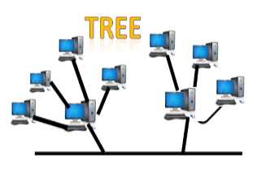
Tree topology

Slide 95
Tree topology
Tree topology combines the characteristics of bus topology and star topology.
A tree topology is a type of structure in which all the computers are connected with each other in hierarchical fashion.
The top-most node in tree topology is known as a root node, and all other nodes are the descendants of the root node.
There is only one path exists between two nodes for the data transmission. Thus, it forms a parent-child hierarchy.

Slide 96
Advantages of Tree topology
Support for broadband transmission: Tree topology is mainly used to provide broadband transmission, i.e., signals are sent over long distances without being attenuated.
Easily expandable: We can add the new device to the existing network. Therefore, we can say that tree topology is easily expandable.
Easily manageable: In tree topology, the whole network is divided into segments known as star networks which can be easily managed and maintained.
Error detection: Error detection and error correction are very easy in a tree topology.
Limited failure: The breakdown in one station does not affect the entire network.
Point-to-point wiring: It has point-to-point wiring for individual segments.

Slide 97
Disadvantages of Tree topology
Difficult troubleshooting: If any fault occurs in the node, then it becomes difficult to troubleshoot the problem.
High cost: Devices required for broadband transmission are very costly.
Failure: A tree topology mainly relies on main bus cable and failure in main bus cable will damage the overall network.
Reconfiguration difficult: If new devices are added, then it becomes difficult to reconfigure.

Slide 98
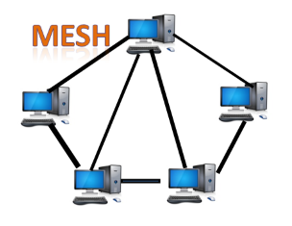
Mesh topology

Slide 99
Mesh topology
Mesh technology is an arrangement of the network in which computers are interconnected with each other through various redundant connections.
There are multiple paths from one computer to another computer.
It does not contain the switch, hub or any central computer which acts as a central point of communication.
The Internet is an example of the mesh topology.
Mesh topology is mainly used for WAN implementations where communication failures are a critical concern.
Mesh topology is mainly used for wireless networks.
Mesh topology can be formed by using the formula: Number of cables = (n*(n-1))/2;
Where n is the number of nodes that represents the network.

Slide 100
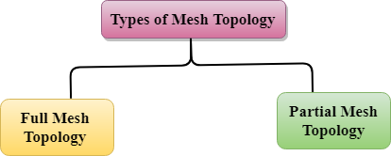
Types of Mesh topology
Fully connected mesh topology
Partially connected mesh topology

Slide 101
Advantages of Mesh topology
Reliable: The mesh topology networks are very reliable as if any link breakdown will not affect the communication between connected computers.
Fast Communication: Communication is very fast between the nodes.
Easier Reconfiguration: Adding new devices would not disrupt the communication between other devices.

Slide 102
Disadvantages of Mesh topology
Cost: A mesh topology contains a large number of connected devices such as a router and more transmission media than other topologies.
Management: Mesh topology networks are very large and very difficult to maintain and manage. If the network is not monitored carefully, then the communication link failure goes undetected.
Efficiency: In this topology, redundant connections are high that reduces the efficiency of the network.

Slide 103
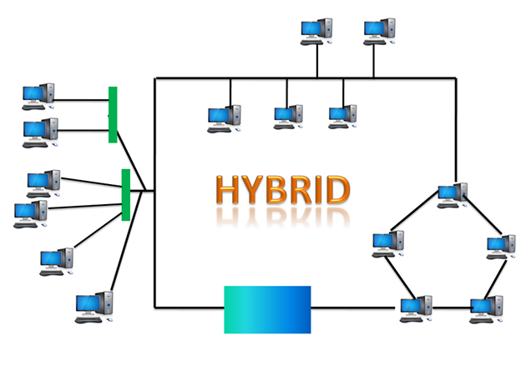
Hybrid Topology

Slide 104
Hybrid Topology
The combination of various different topologies is known as Hybrid topology.
A Hybrid topology is a connection between different links and nodes to transfer the data.
When two or more different topologies are combined together is termed as Hybrid topology and if similar topologies are connected with each other will not result in Hybrid topology.

Slide 105
Advantages of Hybrid Topology
Reliable: If a fault occurs in any part of the network will not affect the functioning of the rest of the network.
Scalable: Size of the network can be easily expanded by adding new devices without affecting the functionality of the existing network.
Flexible: This topology is very flexible as it can be designed according to the requirements of the organization.
Effective: Hybrid topology is very effective as it can be designed in such a way that the strength of the network is maximized and weakness of the network is minimized.

Slide 106
Disadvantages of Hybrid topology
Complex design: The major drawback of the Hybrid topology is the design of the Hybrid network. It is very difficult to design the architecture of the Hybrid network.
Costly Hub: The Hubs used in the Hybrid topology are very expensive as these hubs are different from usual Hubs used in other topologies.
Costly infrastructure: The infrastructure cost is very high as a hybrid network requires a lot of cabling, network devices, etc.

Slide 107
TCP/IP Model
The TCP/IP model consists of Four layers:
Application layer
Transport layer,
Network layer,
Network Access layer
The first four layers provide physical standards, network interface, internetworking, and transport functions that correspond to the first four layers of the OSI model and these four layers are represented in TCP/IP model by a single layer called the application layer.
TCP/IP is a hierarchical protocol made up of interactive modules, and each of them provides specific functionality.

Slide 108
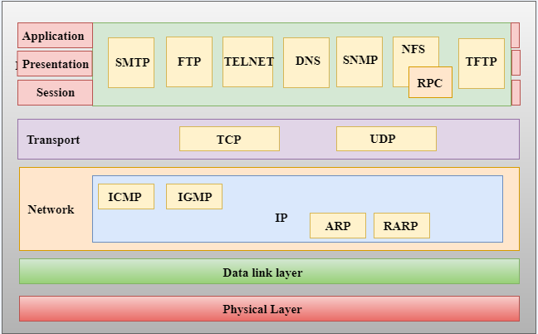

Slide 110
Data Link Layer
The data link layer is the protocol layer in a program that handles how data moves in and out of a physical link in a network.
The data link layer encodes, decodes and organizes data bits in the data link layer before it transports the data bits as frames between two adjacent nodes on the same local area network (LAN) or wide area network.
The data link layer also determines how devices recover from collisions that might occur when nodes attempt to send frames at the same time.

Slide 111
Data Link Layer
The data link layer has two sublayers:
Logical link control (LLC) sublayer
Media access control (MAC) sublayer.
The IEEE 802 LAN specification dictates the LLC sublayer controls data flow among various applications and services, as well as provides acknowledgement and error notification mechanisms.
The LLC sublayer can then talk to a number of IEEE 802 MAC sublayers, which control access to the physical media for transport.
It is also responsible for the physical addressing of frames.
Two common MAC layer types are Ethernet and 802.11 wireless specifications.

Slide 112
Functions of the data link layer
It handles problems that occur as a result of bit transmission errors.
It ensures data flows at a pace that doesn't overwhelm devices that send and receive data.
It permits the transmission of data to Layer 3, the network layer, where it is addressed and routed.
The data link layer ensures an initial connection has been set up, divides output data into data frames and handles the acknowledgements from a receiver that confirms if data has successfully arrived.
It also analyzes bit patterns at special places in the frames, which ensures incoming data has been successfully received.

Slide 113
Functions of the data link layer
If an error occurs, the data link layer notifies higher-level protocols that something has happened to the physical link. Frame sequencing capabilities within the data link layer permit the receiving device to reorder frames that might have been transmitted out of sequence. The data link layer verifies the packet isn't impaired.
The data link layer also manages flows because it can enable devices on a link to detect congestion. Nearby devices then transmit congestion information, so traffic can accordingly reroute on the network.

Slide 114
Network Layer
The Network Layer is the third layer of the OSI model.
It handles the service requests from the transport layer and further forwards the service request to the data link layer.
The network layer translates the logical addresses into physical addresses
It determines the route from the source to the destination and also manages the traffic problems such as switching, routing and controls the congestion of data packets.
The main role of the network layer is to move the packets from sending host to the receiving host.

Slide 115
Functions of Network Layer
Routing: When a packet reaches the router's input link, the router will move the packets to the router's output link.
Logical Addressing: The data link layer implements the physical addressing and network layer implements the logical addressing. Logical addressing is also used to distinguish between source and destination system. The network layer adds a header to the packet which includes the logical addresses of both the sender and the receiver.
Internetworking: This is the main role of the network layer that it provides the logical connection between different types of networks.
Fragmentation: The fragmentation is a process of breaking the packets into the smallest individual data units that travel through different networks.

Slide 116
Forwarding & Routing
In Network layer, a router is used to forward the packets.
Every router has a forwarding table.
A router forwards a packet by examining a packet's header field and then using the header field value to index into the forwarding table.
The value stored in the forwarding table corresponding to the header field value indicates the router's outgoing interface link to which the packet is to be forwarded.

Slide 117
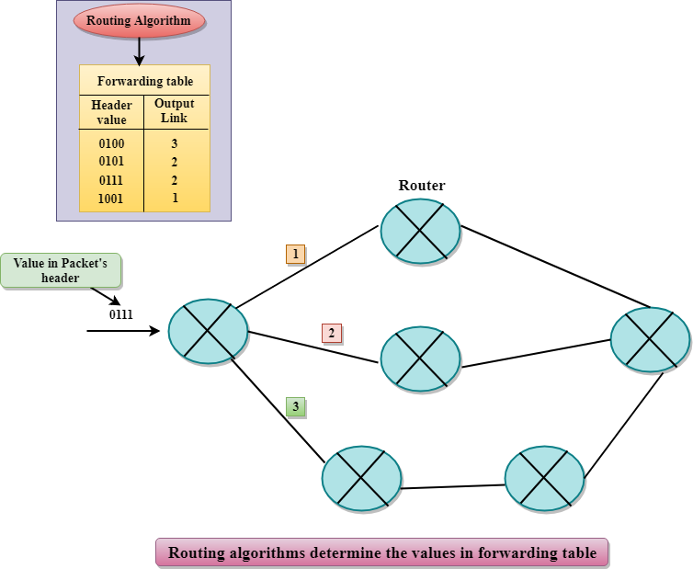

Slide 118
Services Provided by the Network Layer
Guaranteed delivery: This layer provides the service which guarantees that the packet will arrive at its destination.
Guaranteed delivery with bounded delay: This service guarantees that the packet will be delivered within a specified host-to-host delay bound.
In-Order packets: This service ensures that the packet arrives at the destination in the order in which they are sent.
Guaranteed max jitter: This service ensures that the amount of time taken between two successive transmissions at the sender is equal to the time between their receipt at the destination.
Security services: The network layer provides security by using a session key between the source and destination host. The network layer in the source host encrypts the payloads of datagrams being sent to the destination host. The network layer in the destination host would then decrypt the payload. In such a way, the network layer maintains the data integrity and source authentication services.

Slide 119
Conceptual View of Network

Slide 120
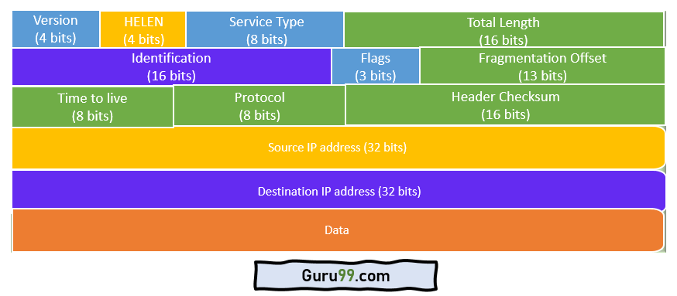
IP- Packets

Slide 121
Description
Version − Version no. of Internet Protocol used (e.g. IPv4).
IHL − Internet Header Length; Length of entire IP header.
DSCP − Differentiated Services Code Point; this is Type of Service.
ECN − Explicit Congestion Notification; It carries information about the congestion seen in the route.
Total Length − Length of entire IP Packet (including IP header and IP Payload).
Identification − If IP packet is fragmented during the transmission, all the fragments contain same identification number. to identify original IP packet they belong to.

Slide 122
Description
Flags − As required by the network resources, if IP Packet is too large to handle, these ‘flags’ tells if they can be fragmented or not. In this 3-bit flag, the MSB is always set to ‘0’.
Fragment Offset − This offset tells the exact position of the fragment in the original IP Packet.
Time to Live − To avoid looping in the network, every packet is sent with some TTL value set, which tells the network how many routers (hops) this packet can cross. At each hop, its value is decremented by one and when the value reaches zero, the packet is discarded.
Protocol − Tells the Network layer at the destination host, to which Protocol this packet belongs to, i.e. the next level Protocol. For example protocol number of ICMP is 1, TCP is 6 and UDP is 17.

Slide 123
Description
Header Checksum − This field is used to keep checksum value of entire header which is then used to check if the packet is received error-free.
Source Address − 32-bit address of the Sender (or source) of the packet.
Destination Address − 32-bit address of the Receiver (or destination) of the packet.
Options − This is optional field, which is used if the value of IHL is greater than 5. These options may contain values for options such as Security, Record Route, Time Stamp, etc.

Slide 124
IP-Address
An IP address is a 32 bit numerical value assigned to a computer on a network.
It is a unique address that distinguishes any device on the internet or any network from another.
An IP address is represented by a series of numbers segregated by periods(.). They are expressed in the form of four pairs - an example address might be 255.255.255.255 wherein each set can range from 0 to 255.

Slide 125
Types of IP addresses
Consumer IP Addresses : Every individual or firm with an active internet service system pursues two types of IP addresses
Private IP Address :
Public IP Address
Dynamic IP Address
Static IP Address
Website IP Addresses
Shared IP Address
Dedicated IP Address

Slide 126
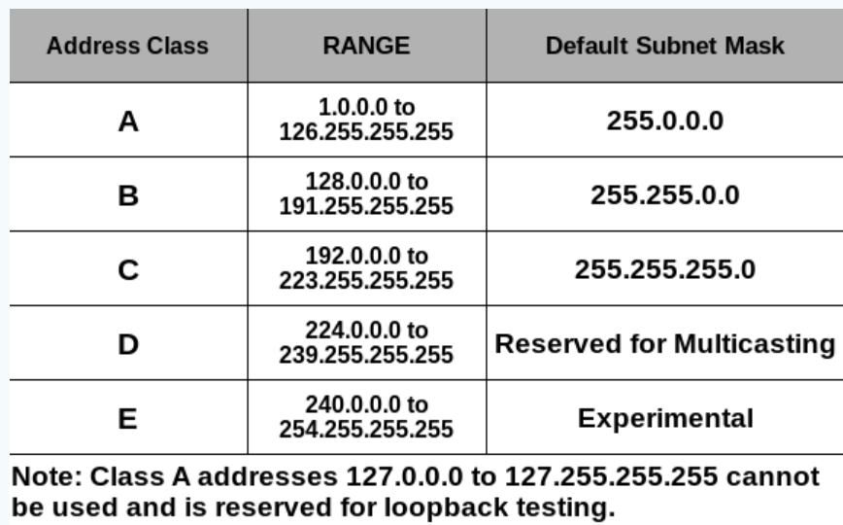
Network Classes

Slide 127
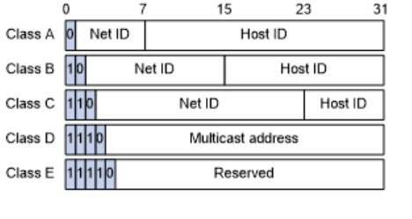
Network Classes
Range :
No of IP Address :
No of Network ID :
No of Host ID :

Slide 128
Class A Network
IP addresses belonging to class A are assigned to the networks that contain a large number of hosts.
The network ID is 8 bits long.
The host ID is 24 bits long.
The higher-order bit of the first octet in class A is always set to 0. The remaining 7 bits in the first octet are used to determine network ID. The 24 bits of host ID are used to determine the host in any network. The default subnet mask for Class A is 255.x.x.x. Therefore, class A has a total of:
2^7-2= 126 network ID(Here 2 address is subtracted because 0.0.0.0 and 127.x.y.z are special address. )
2^24 – 2 = 16,777,214 host ID
IP addresses belonging to class A ranges from 1.x.x.x – 126.x.x.x

Slide 129
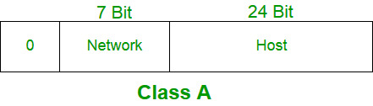
Class A Network

Slide 130
Class B Network
IP address belonging to class B is assigned to networks that range from medium-sized to large-sized networks.
The network ID is 16 bits long.
The host ID is 16 bits long.
The higher-order bits of the first octet of IP addresses of class B are always set to 10. The remaining 14 bits are used to determine the network ID. The 16 bits of host ID are used to determine the host in any network. The default subnet mask for class B is 255.255.x.x. Class B has a total of:
2^14 = 16384 network address
2^16 – 2 = 65534 host address
IP addresses belonging to class B ranges from 128.0.x.x – 191.255.x.x.

Slide 131
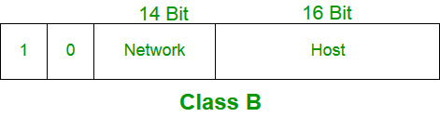
Class B Network

Slide 132
Class C Network
IP addresses belonging to class C are assigned to small-sized networks.
The network ID is 24 bits long.
The host ID is 8 bits long.
The higher-order bits of the first octet of IP addresses of class C is always set to 110. The remaining 21 bits are used to determine the network ID. The 8 bits of host ID are used to determine the host in any network. The default subnet mask for class C is 255.255.255.x. Class C has a total of:
2^21 = 2097152 network address
2^8 – 2 = 254 host address
IP addresses belonging to class C range from 192.0.0.x – 223.255.255.x.

Slide 133
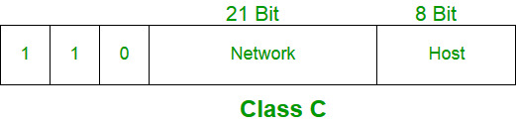
Class C Network

Slide 134
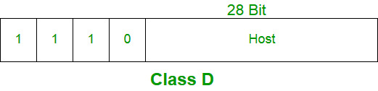
Class D Network
IP address belonging to class D is reserved for multi-casting.
The higher-order bits of the first octet of IP addresses belonging to class D is always set to 1110.
The remaining bits are for the address that interested hosts recognize.
Class D does not possess any subnet mask. IP addresses belonging to class D range from 224.0.0.0 – 239.255.255.255.

Slide 135
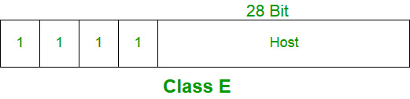
Class E Network
IP addresses belonging to class E are reserved for experimental and research purposes.
IP addresses of class E range from 240.0.0.0 – 255.255.255.254. This class doesn’t have any subnet mask.
The higher-order bits of the first octet of class E are always set to 1111.

Slide 136
Transport layer

Slide 138
Transport layer
Transport Layer is the fourth layer from the top in OSI Model which provides communication services to the application processes that are running on different hosts.
Transport Layer provides the services to the session layer and it receives the services from the network layer.
The services provided by transport layer include error correction as well as segmenting and desegmenting data before and after it's sent on the network.
Transport layer also provides the flow control functionality and ensures that segmented data is delivered across the network in the right sequence.

Slide 139
Services Provided by Transport Layer Process to Process Communication
Transport Layer is responsible for delivery of message to the appropriate process.
Transport Layer uses a port number to deliver the segmented data to the correct process amongst the multiple processes that are running on a particular host.
A port number is a 16-bit address used by transport layer to identify any client-server program.

Slide 140
Services Provided by Transport Layer Multiplexing and Demultiplexing
Multiplexing is a technique used to combine and send the multiple data streams over a single medium.
The transport layer provides the multiplexing service to improve transmission efficiency in data communication. At the receiver side, demultiplexing is required to collect the data coming from different processes.
Upward multiplexing : means multiple transport layer connections utilize the connection of the same network. Transport layer transmits several transmissions bound for the same destination along the same path in network.
Downward multiplexing : means a transport layer connection utilizes the multiple connections. This multiplexing allows the transport layer to split a network connection among several paths to improve the throughput in the network.

Slide 141
Services Provided by Transport Layer Flow Control
Flow control makes sure that the data is transmitted at a rate that is acceptable for both sender and receiver by managing data flow.
The transport layer provides a flow control service between the adjacent layers of the TCP/IP model. Transport Layer uses the concept of sliding window protocol to provide flow control.

Slide 142
Services Provided by Transport Layer Data Integrity
Transport Layer provides data integrity by:
Detecting and discarding corrupted packets.
Tracking of lost and discarded packets and re-transmitting them.
Recognizing duplicate packets and discarding them.
Buffering out-of-order packets until the missing packets arrive.

Slide 143
Services Provided by Transport Layer Congestion avoidance
In network, if the load on the network is greater than the network load capacity, then the congestion may occur.
Congestion Control refers to the mechanisms and techniques to control the congestion and keep the load below the capacity.
The transport layer recognizes overloaded nodes and reduced flow rates and takes proper steps to overcome this.

Slide 144
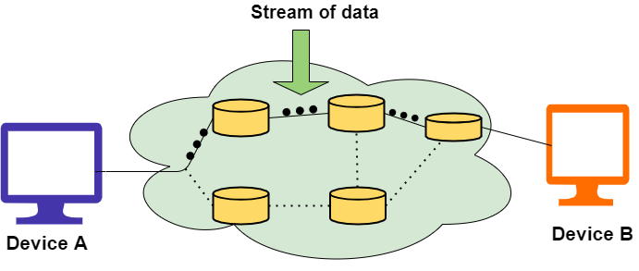
Connection Oriented Communication

Slide 145
Connection Oriented Communication
There is a sequence of operations to be followed by the users of connection-oriented service. These are:
The connection is established.
Information is sent.
The connection is released.

Slide 146
Advantages
Benefits of Connection-Oriented Services are as follows:
Connection-Oriented Services are reliable.
There is no duplication of data packets.
There are no chances of Congestion.
These are Suitable for long connections.
Sequencing of data packets is guaranteed.

Slide 147
Drawbacks of Connection-Oriented Service
This allocation of resources is mandatory before communication.
The speed of connection is slower. As much time is taken for establishing and relinquishing the connection.
In the case of Network Congestion or router failures, there are no alternative ways to continue with communication.

Slide 148
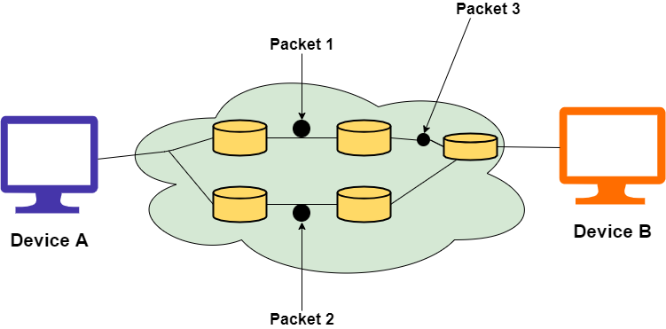
Connectionless Communication

Slide 149
Advantages
There are usually low overheads.
Connectionless services help to broadcast or multicast messages to multiple recipients. In this, there is no circuit setup. Thus it takes a fraction of a minute in order to establish a connection.
In the case of Network congestion or router failures, it has an alternative path of data transmission.

Slide 150
Disadvantages
These are susceptible to congestion in the network.
It is not reliable as there is the possibility of a loss of data packets, wrong delivery of packets or duplication is high.
In this, each data packet needs lengthy fields because these are supposed to hold all the destination addresses and the routing information.

Slide 151
Connection Oriented Vs Connectionless
Connection-Oriented Services | Connection Less Services
Connection-Oriented services are designed on the basis of the Telephone System. | Connectionless services are based on the Postal System.
In this type of service, a prior connection needs to be established. | In this type of service, no prior connection is needed.
These services Ensure the reliable transfer of data. | As these services are best efforts services but reliability is not guaranteed in these.
There is no possibility of congestion. | There are chances of occurrence of congestion using these services.
In this authentication is required before transmitting the data packets to the receiver. | In this, authentication is not required before transmitting the data packets to the receiver.
These services are suitable for long and steady transmissions. | These services are suitable for bursty transmissions.

Slide 152
Connection Oriented Vs Connectionless
Connection-Oriented Services | Connection Less Services
In this connection is established through the process of signaling | There is no such signaling concept exists.
In this type of service, data packets travel towards their destination node in a sequential manner. | In this type of service, data packets travel towards their destination node in a random manner.
Retransmission of lost data bits is possible. | In this, it is not possible.
Delay is more while transferring the information. But after the establishment of connection, these services offer fast delivery of information. | Due to the absence of the connection establishment phase, there is no delay.

Slide 153
Working of Transport Layer
The transport layer receives the services from the network layer and then gives services to the session layer.
At the sender’s side: At the sender's end, transport layer collect data from application layer i.e. message, and performs segmentation to divide the message into segments and then adds the port number of the source and destination in the header and sends that message to network layer.
At the receiver’s side: At the receiver's end, transport layer collects data from network layer and then reassembles the segmented data and identifies the port number by reading its header to send that message to the appropriate port in the session layer.

Slide 154
Transport Layer Protocols
UDP (User Datagram Protocol)
TCP(Transmission Control Protocol)
SCTP (Stream Control Transmission Protocol)

Slide 155
UDP (User Datagram Protocol)
UDP is one of the simplest transport layer protocols which provides non-sequenced data transmission functionality.
UDP is considered as a connectionless transport layer protocol.
This type of protocol is referred to be used when speed and size are more important than reliability and security.
It is an end-to-end transport-level protocol that adds transport-level addresses, checksum error control, and length information to the data received from the upper layer.
User datagram is the packet constructed by the UDP protocol

Slide 156
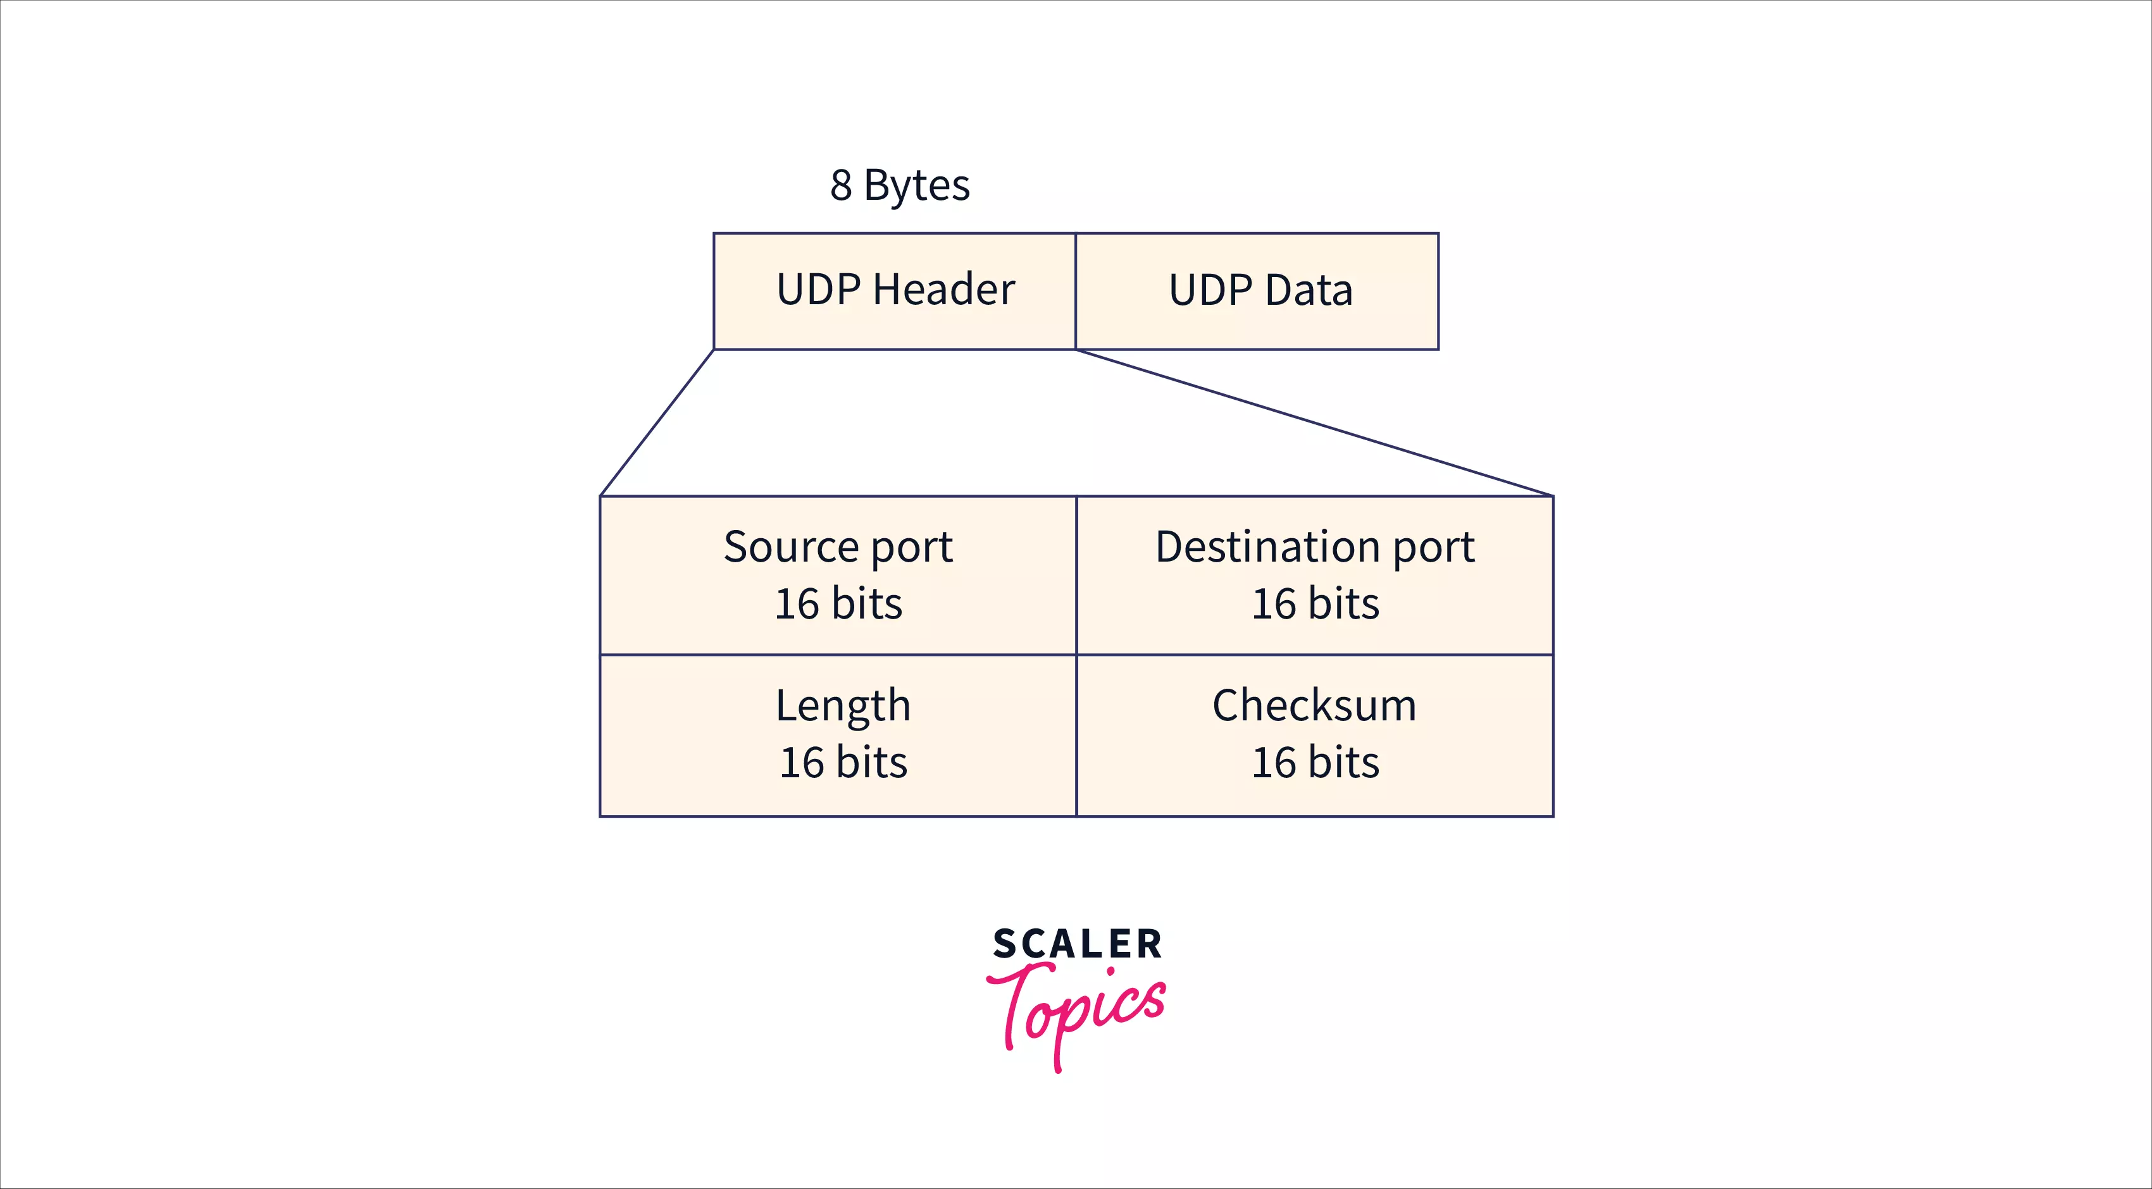
Format of User Datagram

Slide 157
Format of User Datagram ( 8 Bytes)
Source port address: It defines the source port number and it is 16 bits.
Destination port address: It defines the destination port number and it is 16 bits.
Total length: This field is used to define the total length of the user datagram which is the sum of header and data length in bytes. It is a 16-bit field.
Checksum: Checksum is also a 16-bit field to carry the optional error detection data.

Slide 158
UDP Services
Process to Process Communication
Connectionless Service
Fast delivery of the message
Checksum

Slide 159
Disadvantages
UDP delivers basic functions required for the end-to-end transmission of data.
It does not use any sequencing and does not identify the damaged packet while reporting an error.
UDP can identify that an error has happened, but UDP does not identify which packet has been lost.

Slide 160
Transmission Control Protocol (TCP)
TCP is a connection-oriented transport layer protocol.
TCP explicitly defines connection establishment, data transfer, and connection tear-down phases to provide connection-oriented service for data transmission.

Slide 161
Features of TCP Protocol
Stream data transfer
Reliability
Flow Control
Error Control
Multiplexing
Logical Connections
Full Duplex

Slide 162
TCP Segment Format

Slide 163
TCP Segment Format
Source port address is a 16-bit field that defines the port number of an application program that is sending the segment.
Destination port address is a 16-bit field that defines the port number of an application program that is receiving the segment.
Sequence number is a field of 32 bits that will define the number assigned to data's first byte contained in the segment.
Acknowledgement number is a 32-bit field that describes the next byte that the receiver is looking forward to receiving from sender.
Header Length (HLEN) is a field of 4 bit that specify the number of 4-byte words in TCP header. The header length of TCP header can be between 20 to 60 bytes.

Slide 164
TCP Segment Format
Reserved is a field 6 bit that is reserved for future use.
Control bits are 6 different independent control bits or flags in this field.
URG: Urgent pointer
ACK: Acknowledgement number
PSH: Push request
RST: Reset connection
SYN: Sequence number Synchronization
FIN: Connection termination

Slide 165
TCP Segment Format
Window Size is a 16-bit field that defines the size of the window of sending TCP in bytes.
Checksum, 16-bit field contains checksum and is used for error detection.
Urgent pointer is a 16 bit field. This flag is set when there is urgent data in the data segment.
Options and padding can be up to 40 bytes field for optional information in TCP header.

Slide 166
Differences b/w TCP & UDP
Basis of Comparision | TCP | UDP
Definition | TCP establishes a virtual circuit before transmitting the data. | UDP transmits the data directly to the destination computer without verifying whether the receiver is ready to receive or not.
Connection Type | It is a Connection-Oriented protocol | It is a Connectionless protocol
Speed | slow | High
Reliability | It is a reliable protocol. | It is an unreliable protocol.
Header size | 20 bytes | 8 bytes
acknowledgement | It waits for the acknowledgement of data and has the ability to resend the lost packets. | It neither takes the acknowledgement, nor it retransmits the damaged frame.

Slide 167
Stream Control Transmission Protocol(SCTP)
SCTP is one of the connection-oriented transport layer protocols.
It allows the transmission of data between sender and receiver in full duplex mode.
This protocol makes it simpler to build connections over a wireless network and to control multimedia data transmission.

Slide 168
Stream Control Transmission Protocol(SCTP)
Unicast with Multiple Properties
Reliable Transmission
Message oriented
Multi-homing

Slide 169
Application layer

Slide 172
Application Layer
In the OSI model, the application layer is the layer closest to the end-user, implying that the application layer and the end-user can interact directly with the software application.
The application layer isn't an application. Instead, it's a component within an application that manages how data is sent to and received from other devices.
It's an abstraction layer service that hides the rest of the program from the transmission.

Slide 173
Application Layer
The application layer is the topmost layer of the OSI model and the TCP/IP model.
In TCP/IP model, the application layer is formed by combining the top three layers, i.e., the application layer, the presentation layer, and the session layer.
An application layer is an abstraction layer that specifies the shared communications protocols and interface methods used by hosts in a communications network.
It is the layer closest to the end-user, implying that the application layer and the end-user can interact directly with the software application.

Slide 175
Services provided by Application Layer
The application layer guarantees that the receiver is recognized, accessible, and ready to receive data from the sender.
It enables authentication between devices for an extra layer of network security.
It determines the protocol and data syntax rules at the application level.
The protocols of the application layer also define the basic syntax of the message being forwarded or retrieved.
It also checks whether the sender's computer has the necessary communication interfaces, such as an Ethernet or Wi-Fi interface.
Finally, the data on the receiving end is presented to the user application.

Slide 176
Functions of the Application Layer
The Application Layer provides protocols that allow the software to communicate and receive data and finally present it to users in a meaningful way.
This layer allows users to log on as a remote host.
The Application Layer provides various facilities for users to forward multiple emails and a storage facility.
This layer acts as a window via which users and application processes can access network resources.
This layer provides services such as email, file transfer, results distribution, directory services, network resources, etc.

Slide 177
Functions of the Application Layer
The application layer communicates with the operating system and guarantees that data is properly saved.
This layer allows users to interact with other software applications.
This application layer generally performs host initialization followed by remote login to hosts.
This layer visualizes data, allowing individuals to grasp it rather than memorize it or see it in binary format (1s or 0s).

Slide 178
Application Architecture
Client-server architecture:
An application program running on the local machine sends a request to another application program is known as a client, and a program that serves a request is known as a server.
P2P (peer-to-peer) architecture:
The peers communicate with each other without passing the information through a dedicated server, this architecture is known as peer-to-peer architecture. The applications based on P2P architecture includes file sharing and internet telephony.

Slide 179
Application layer protocols
WWW
DNS
HTTP/HTTPS
SMTP
SNMP
FTP
TFTP
TELNET

